Slide 1
Empathy and Distress Prediction using Transformer Multi-output Regression and Emotion Analysis with an Ensemble of Supervised and Zero-Shot Learning Models
Submitted by :
Group-1
21266009 - Naima Nazly
22173009 - Shiva Bahadur Pathak
22366009 - Niloy Dey
22366029 - Khondoker Nazia Iqbal
22373001 - Fahmee Faiza

Slide 2
Introduction
Two inextricably related concepts to emotions that have received less attention are empathy and distress.
SINAI team in the Shared Task on Empathy and Personality Detection and Emotion Classification (WASSA 2022) are proposed four main tracks that aim to develop models that can predict empathy, distress, emotion, and personality traits in reaction to English news articles.

Slide 3
Dataset
Dataset | Instances
Training | 1860
Development | 270
Test | 525

Slide 4
System Description
A multi-output regression task.
Two main approaches:
A single multi-output regression model.
Two separated regression models.
Track 1: Empathy Prediction

Slide 5
Tested on: Three models
Roberta-large
Bert-base-uncased
BERT
A Robustly Optimized BERT Pre-Training Approach.
Fine-tuned on the GoEmotions dataset.
Contains Reddit comments labeled for 27 emotion categories plus neutral.
A distilled version.
Fine-tuned on the CARER dataset.
Contains Twitter messages labeled with six basic emotions: anger, fear, joy, love, sadness and surprise.

Slide 6
Approaches
Multi-output regression model
Separated regression models
Both empathy and distress prediction are learned at the same time.
A single transformer model is fine-tuned.
Minimizing the average between the mean squared error (MSE).
Focused on predicting each class separately.
Fine-tuning two different models.

Slide 7
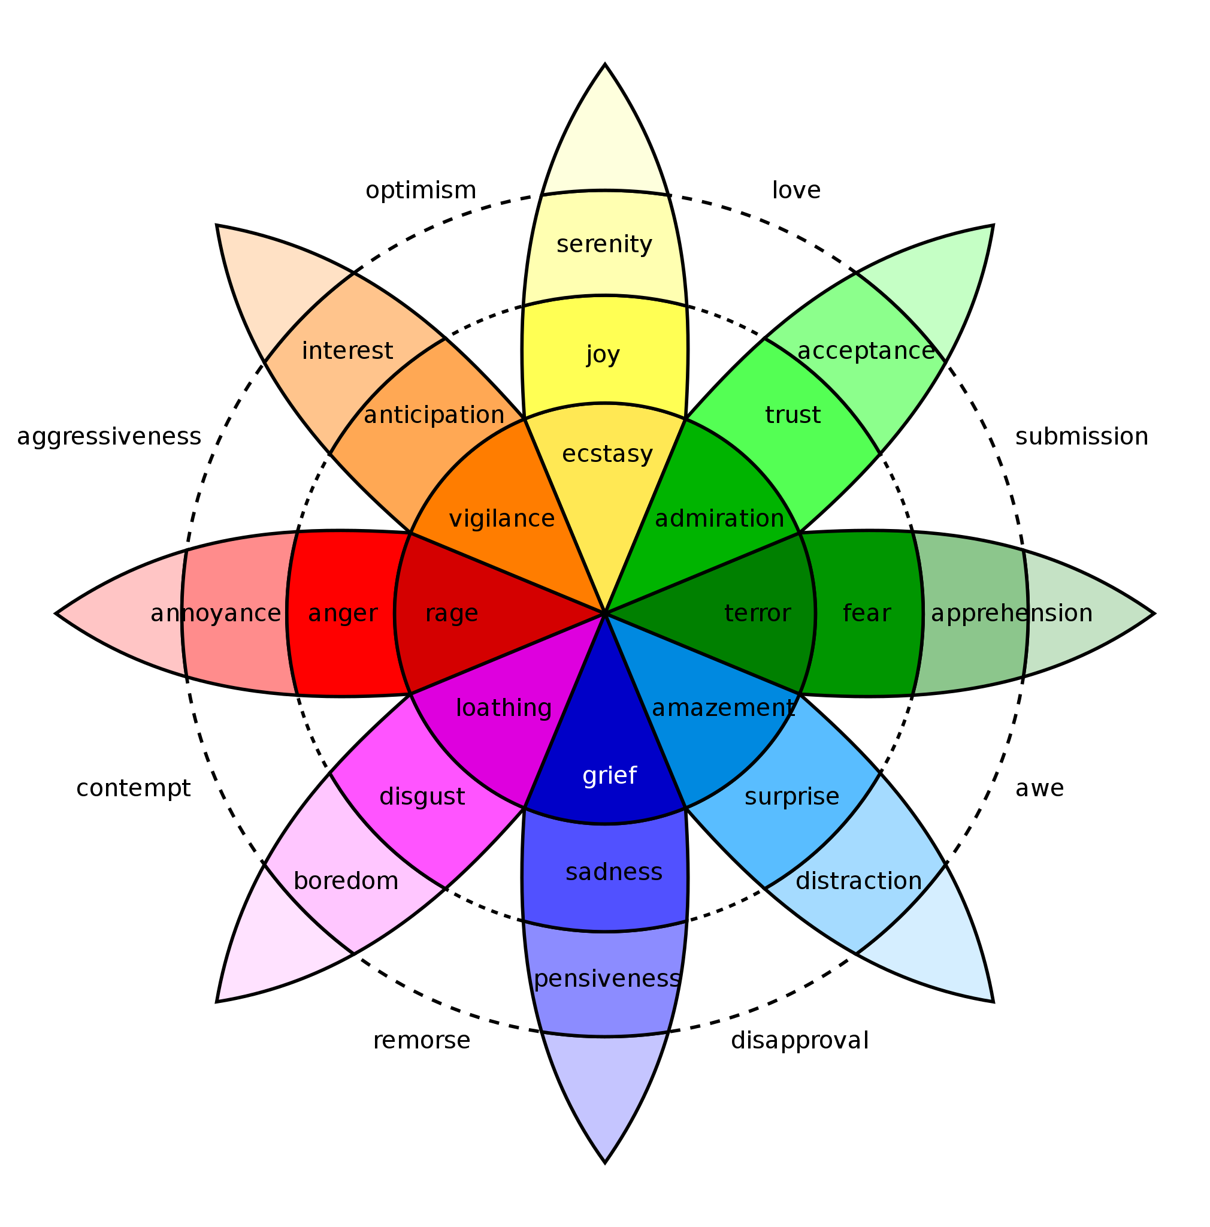
System Description
Track 2: Emotional Classification
* Image might be misleading

Slide 8
CLASSES
Anger
Fear
Sadness
Joy
Disgust
Surprise
Neutral

Slide 9
NLP (Natural Language Processing):
Supervised Learning:
Transformer:
ZSL (Zero Shot Learning):
NLI (Natural Language Interface):
GPT-3 (Generative Pre-trained Transformer 3):
RoBERTa (Robustly Optimized BERT Pre Training Approach)
DeBERTa (Decoding-enhanced BERT with Disentangled Attention)
Davinci

Slide 10
FINAL ENSEMBLE
DATA PROCESSING
RoBERTa
NLI
GPT-3
Ensemble

Slide 11
Experimental
Setup
Fine tuning using a single NVIDIA Ampere A100 GPU
Hugging face transformer library
Grid search is used in hyperparameter tuning
The batch size values were 8, 16 and 32
Models were trained with 2-3 epoch until it starts to overfit with the training data

Slide 12
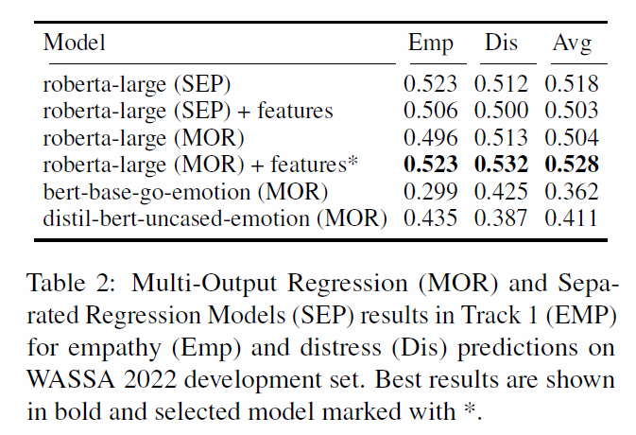
Results
Table 1: Multi-Output Regression (MOR) and Separated Regression Models (SEP) results in Track 1

Slide 13
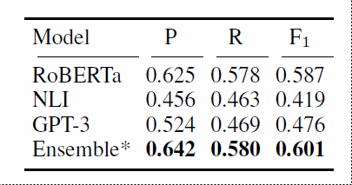
Results
Table 2: RoBERTa, NLI, GPT-3 and Ensemble models results in Track 2

Slide 14


Evaluation
Phase
Train System with Joint Training and Development Sets
Evaluate system with Test Sets
Empathy Prediction Track
2nd Ranked in EMP Track
Emotion Classification Track
3rd Ranked in EMO Track

Slide 15
Conclusion
SINAI Research Group
Empathy & Personality detection and Emotion Classification
Empathy Prediction
Raw language Model RoBERTa in a multi output regression
Features
Emotion Knowledge
Not all model can predict properly which is previously fine-tuned
Emotion Classification
Emotion Detection
ZSL model include NLI and GPT-3
Emotion detection can be promising when no label data available.
Ensemble model
Proposal 2nd and 3rd rank among all participants
Future work :
Further explore ZSL model for emotion classification

Slide 16
Thank You

